Slide 1
The IMOS Animal Tracking Facility
Overview and Data Flows
Xavier Hoenner
Australian Ocean Data Network
April 2018

Slide 2


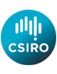


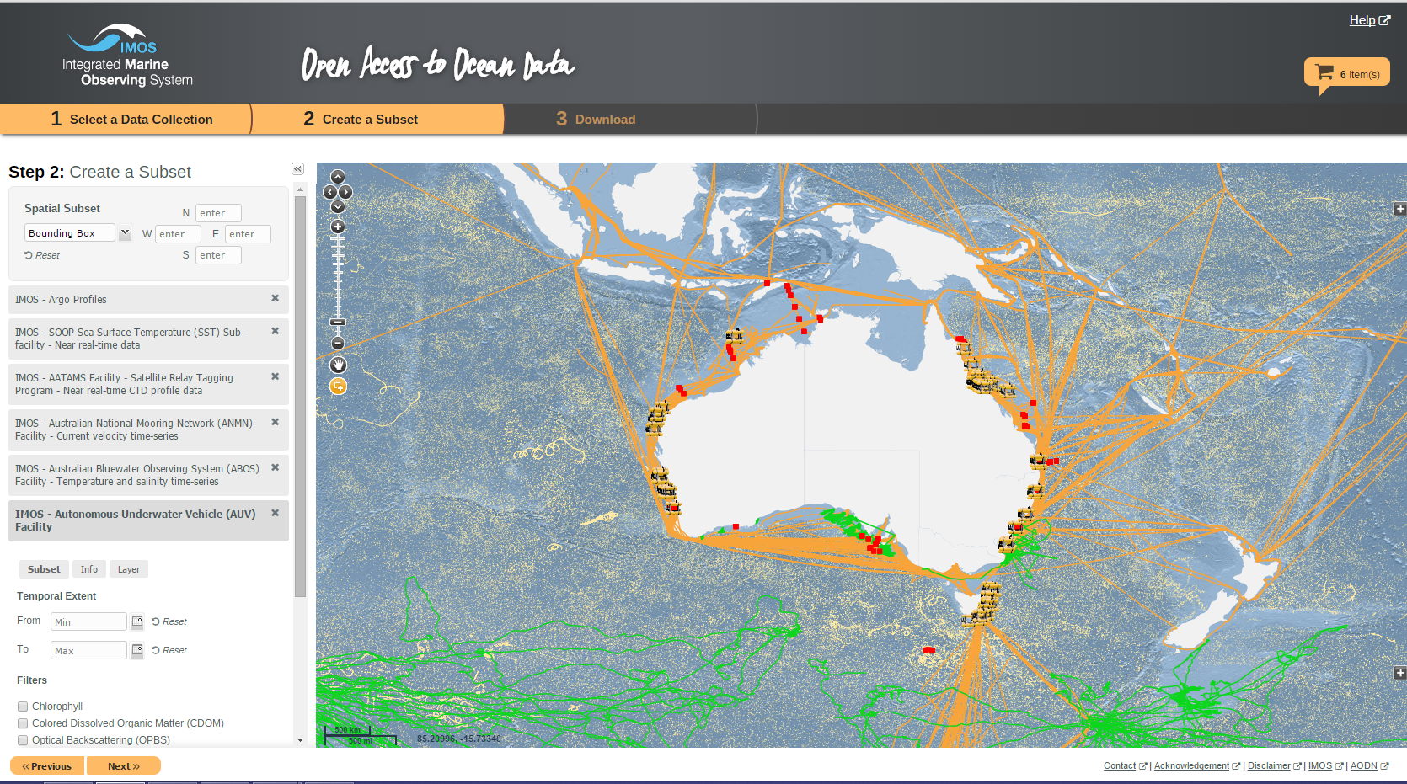








IMOS is a national, collaborative, research infrastructure, funded by Australian Government
Systematic and sustained observing of the marine environment
Open data access

Slide 3
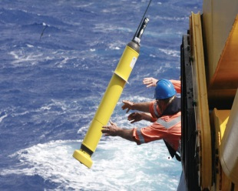
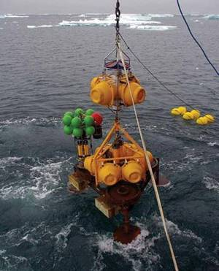
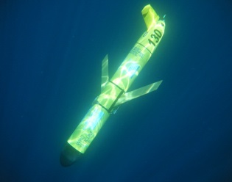
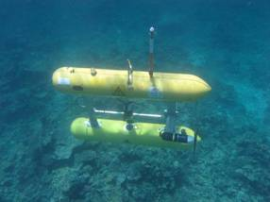
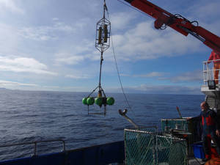
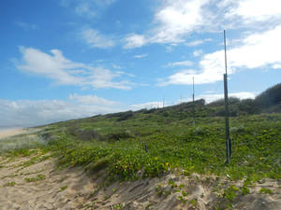
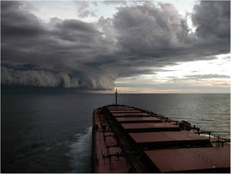
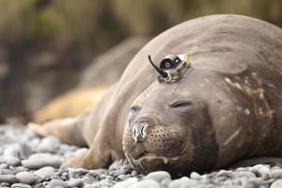
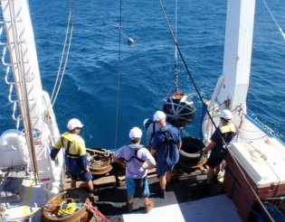
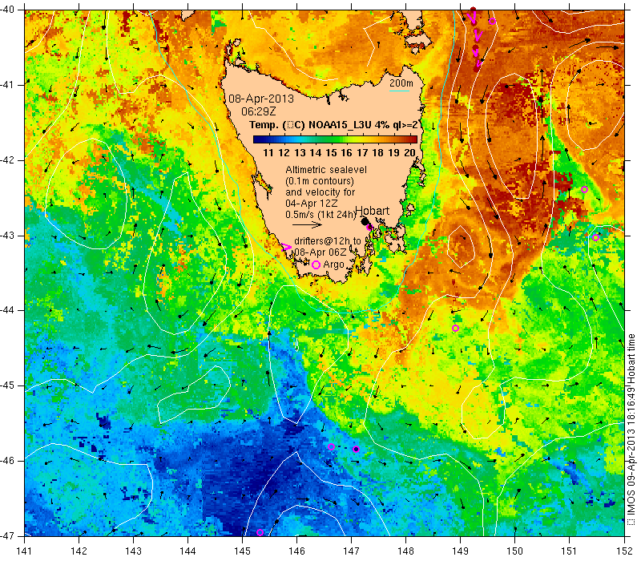
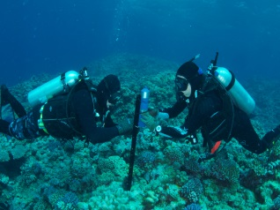
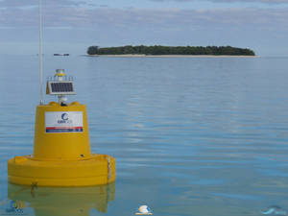
IMOS capability – integrated across scales
Open ocean
Shelf
Coastal

Slide 4
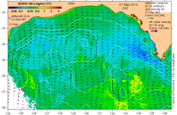
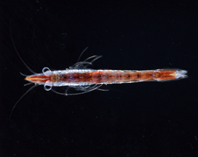
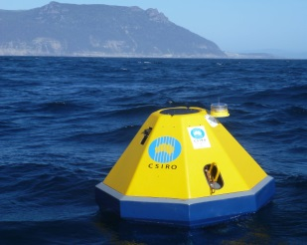
IMOS capability – integrated across disciplines
Physics
Chemistry
Biology

Slide 5

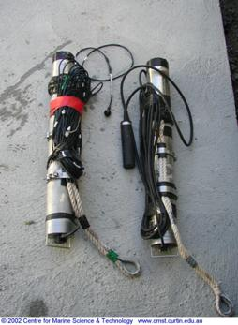

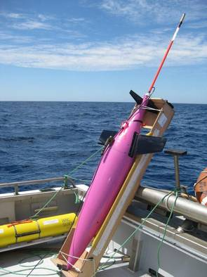
What is IMOS?
Argo floats
Ships
Deepwater moorings
Ocean gliders
AUV
Coastal moorings
Sensor networks
Animal tracking
Satellite
Ocean Radar

Slide 6
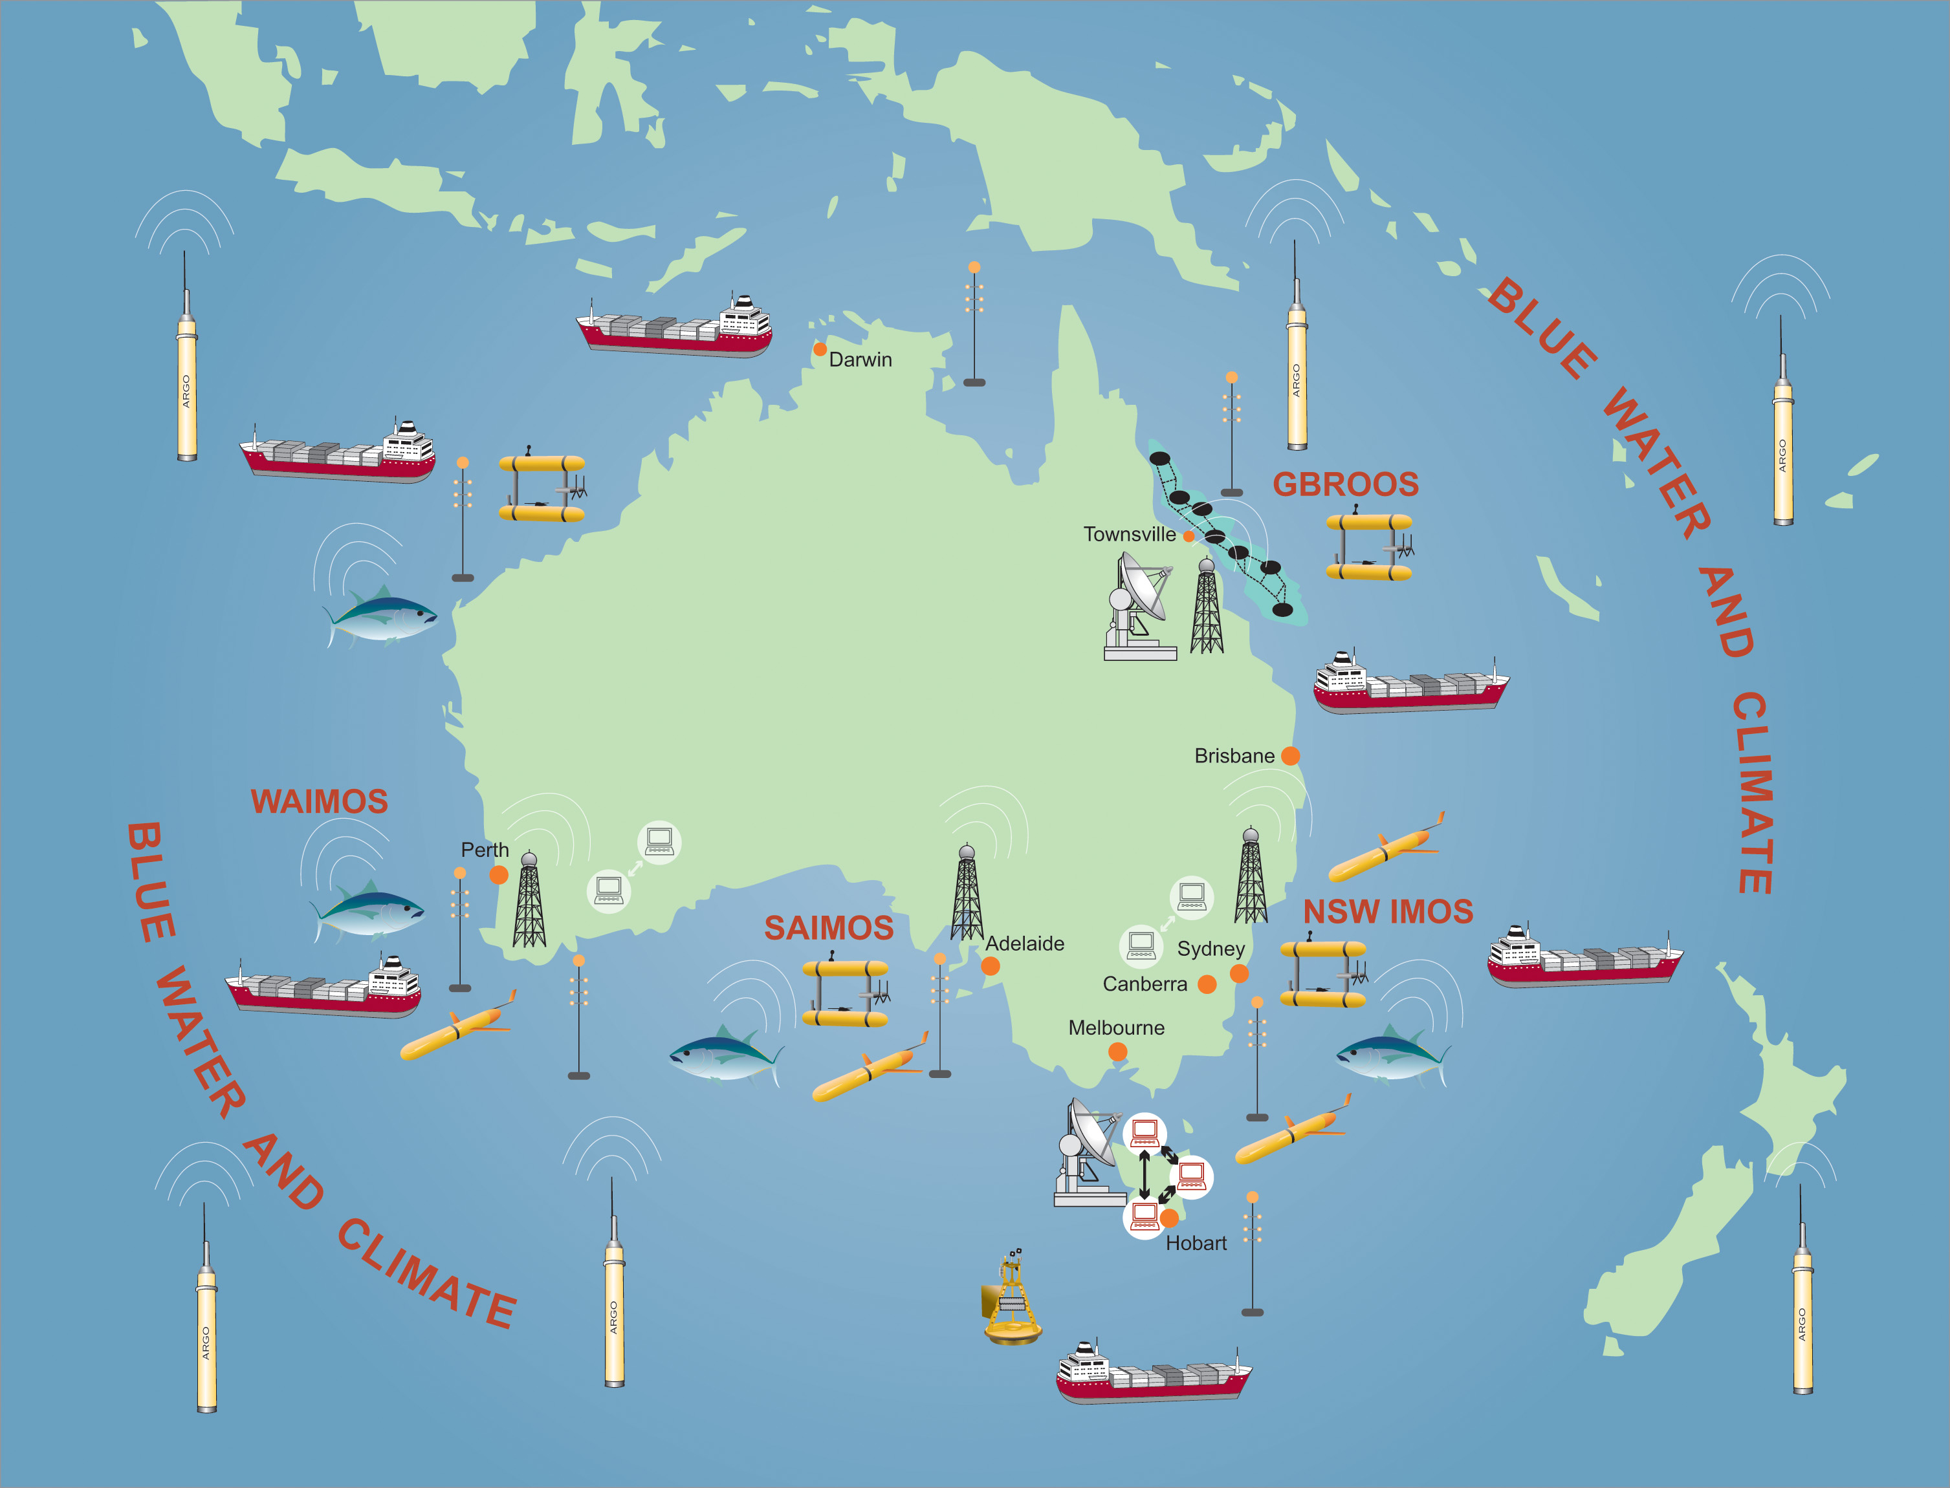
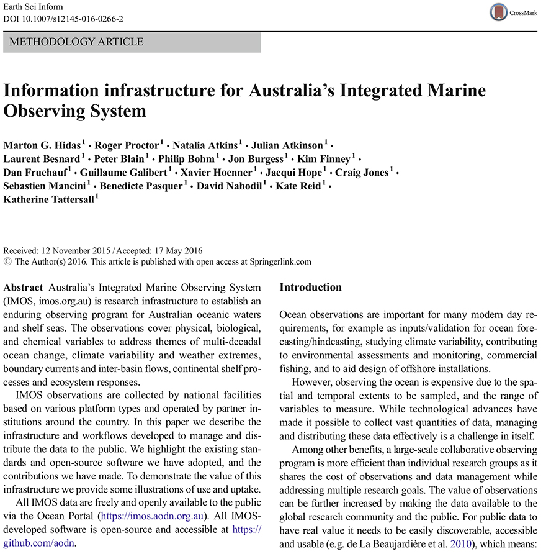

Data Management: Overview
IMOS
Facility
Pipeline processing
Data
Postgres
Geoserver
Internet
Web
services
GeoNetwork
Conformance
Checker
Other
processes
Data
harvester
S3
THREDDS
ncWMS
IMOS
WMS, WFS, WPS
Metadata
AODN
Internet
Metadata
GeoNetwork
AODN
contributor
Internet
WMS, WFS, WPS
AODN portal
User

Slide 7
Satellite tagging program
400 SMRU tags: CTD mainly
2007 - 2018
180,000 CTD profiles
3 million measurements

Slide 8
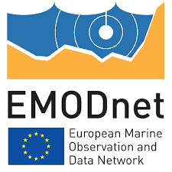


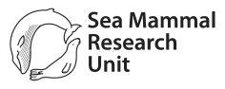
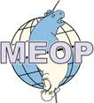
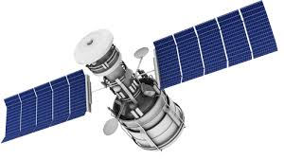
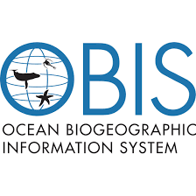

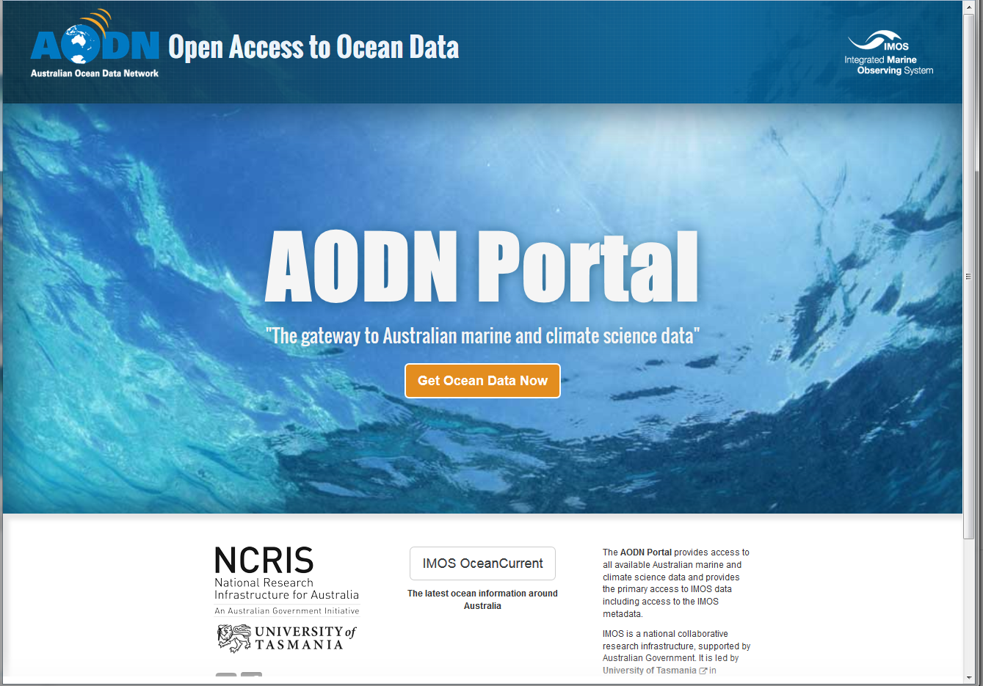



GTS
User
Google Drive
RT data
Text
All data [CTD, dives, Argos location, haulout]
MS Access
QC on CTD data
netCDF and ODV
FTP
FTP
FTP
+
Release metadata in XLS
OBIS-ENV
WMS/WFS
netCDF files on THREDDS

Slide 9
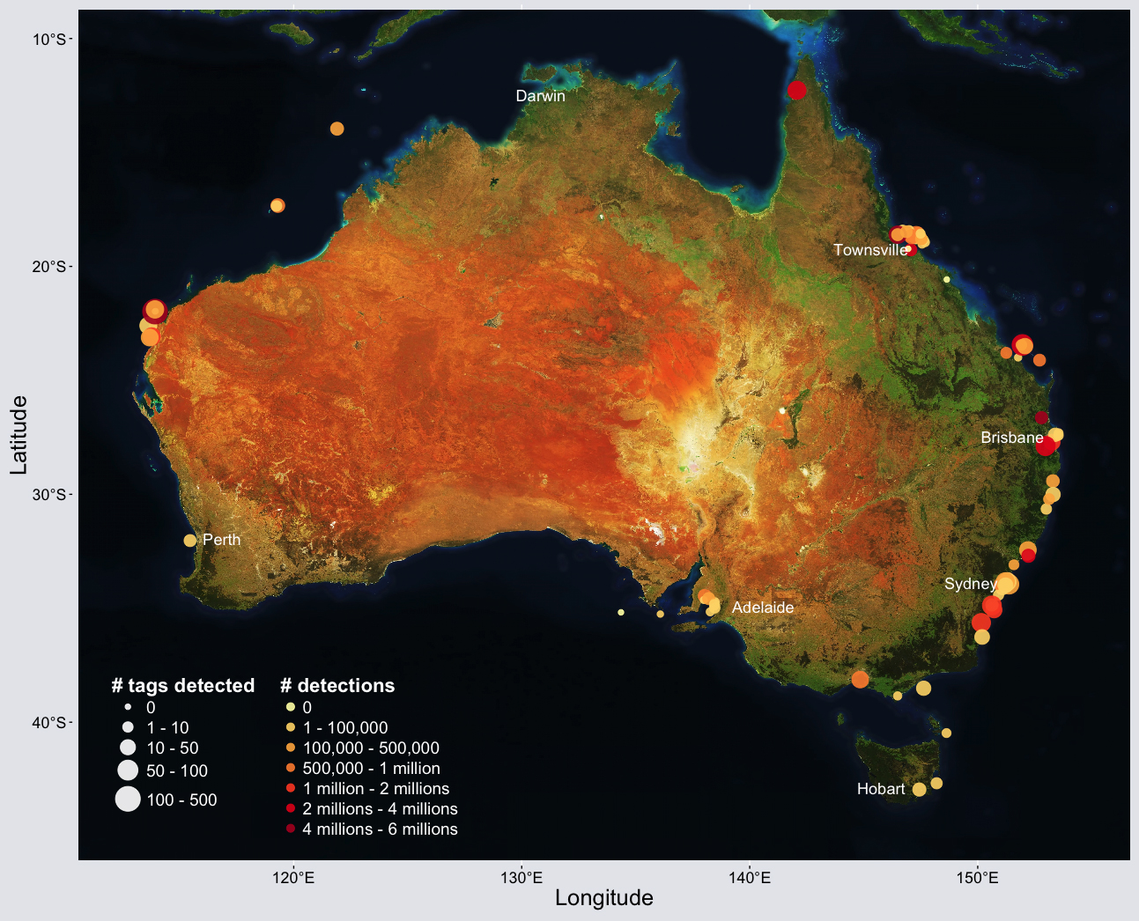
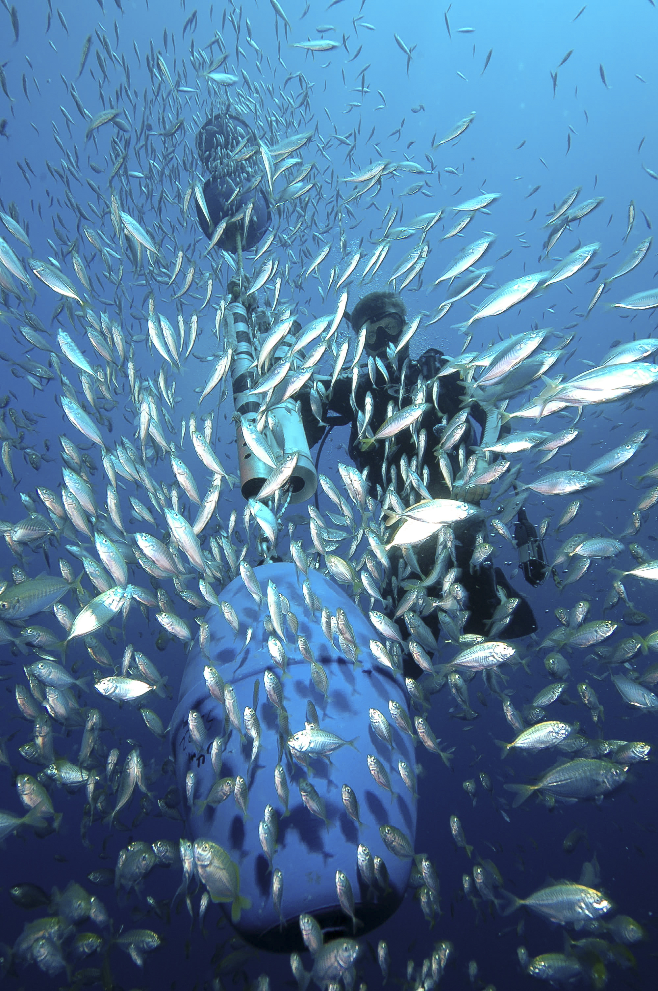
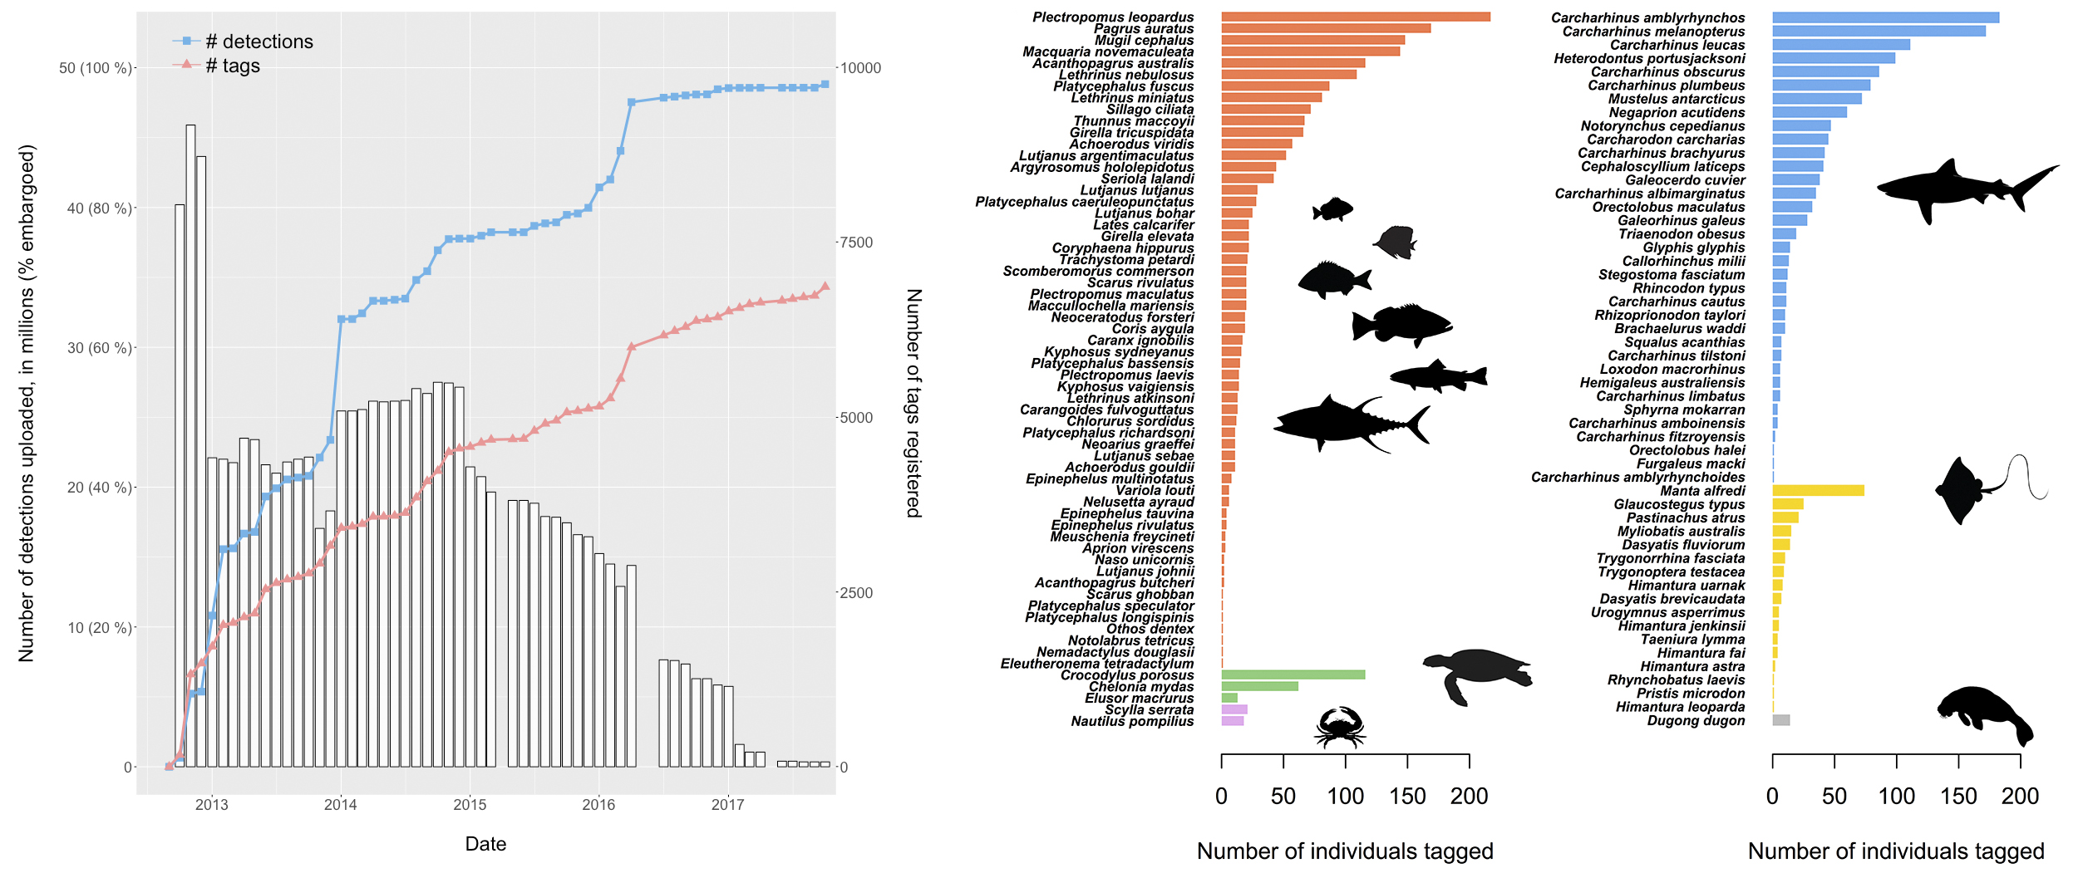
Acoustic telemetry network

Slide 10
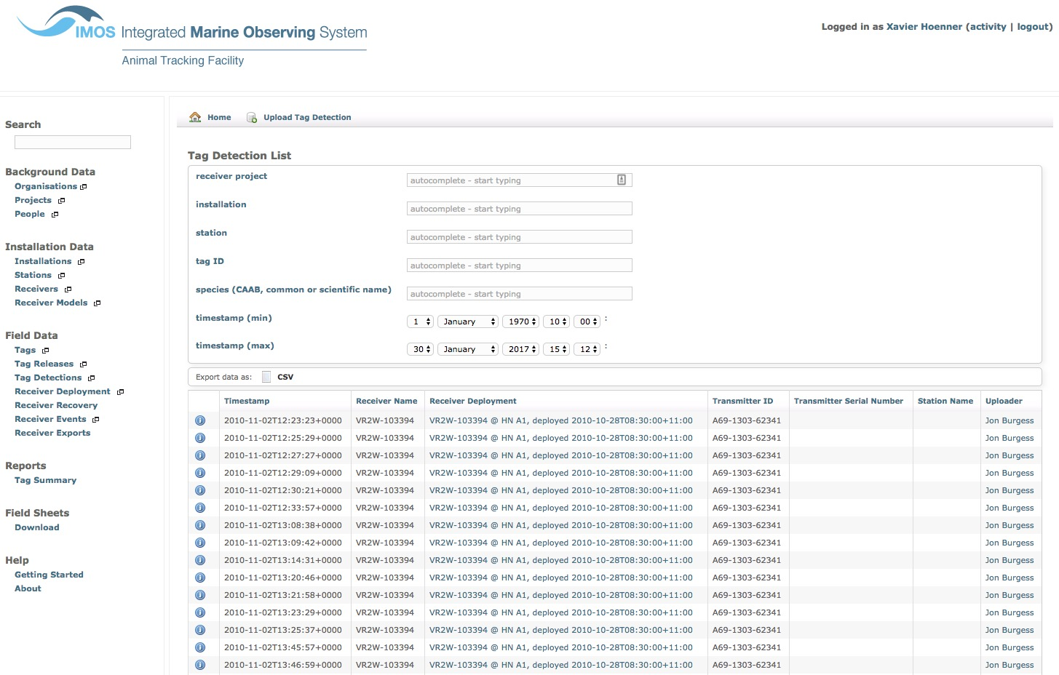
Acoustic telemetry web application

Slide 11
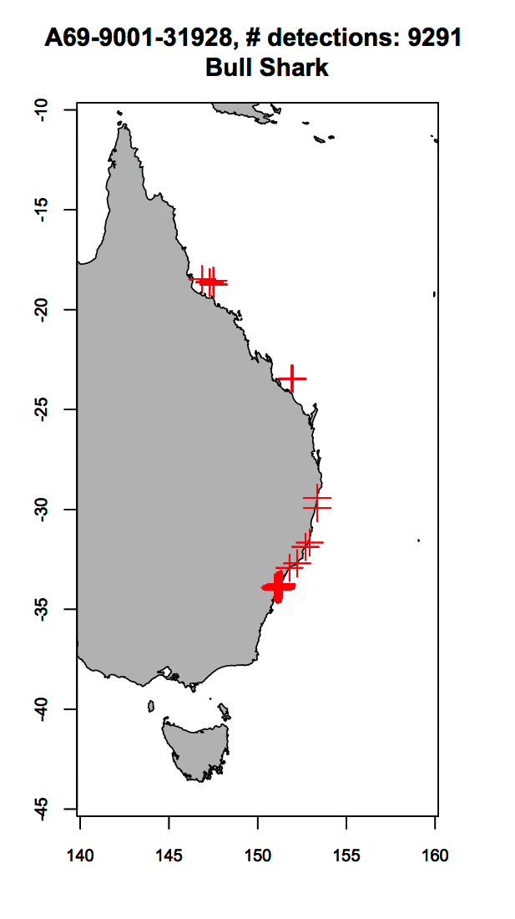
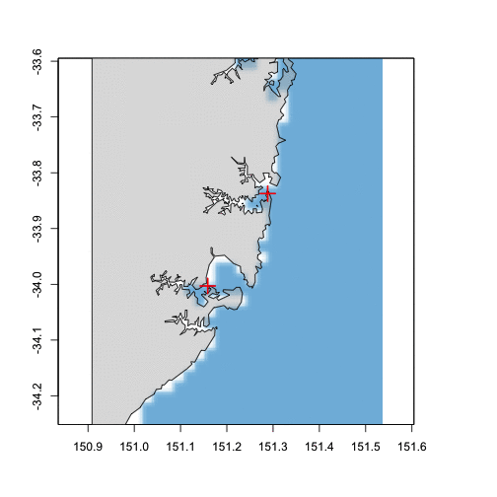
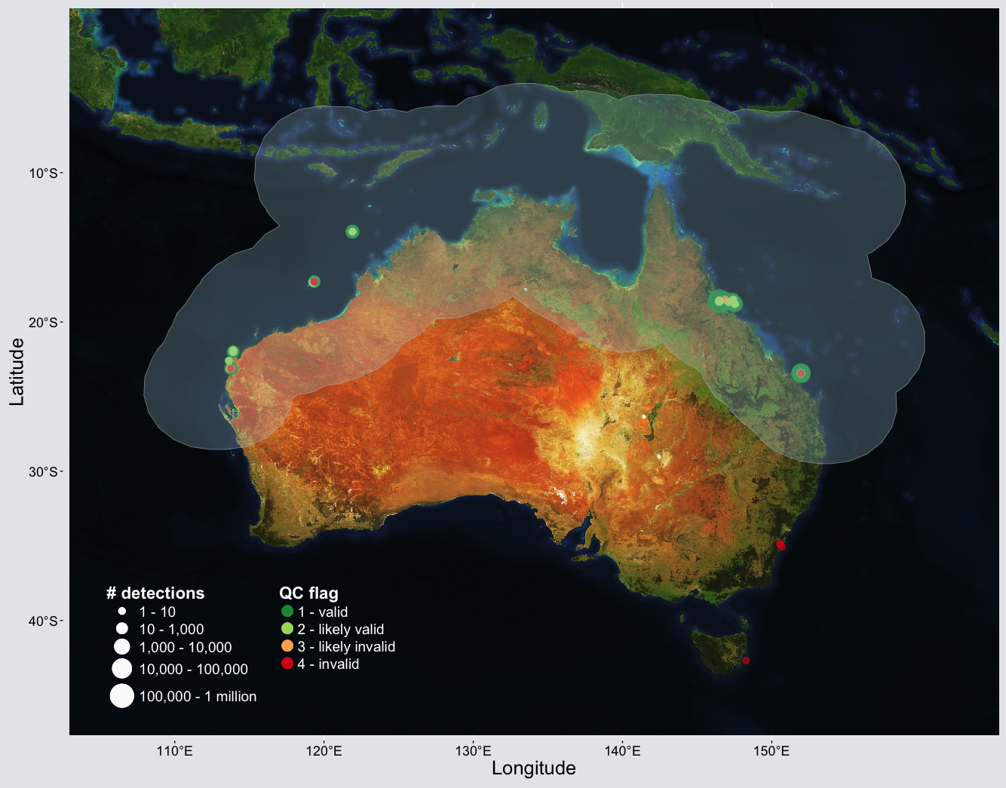
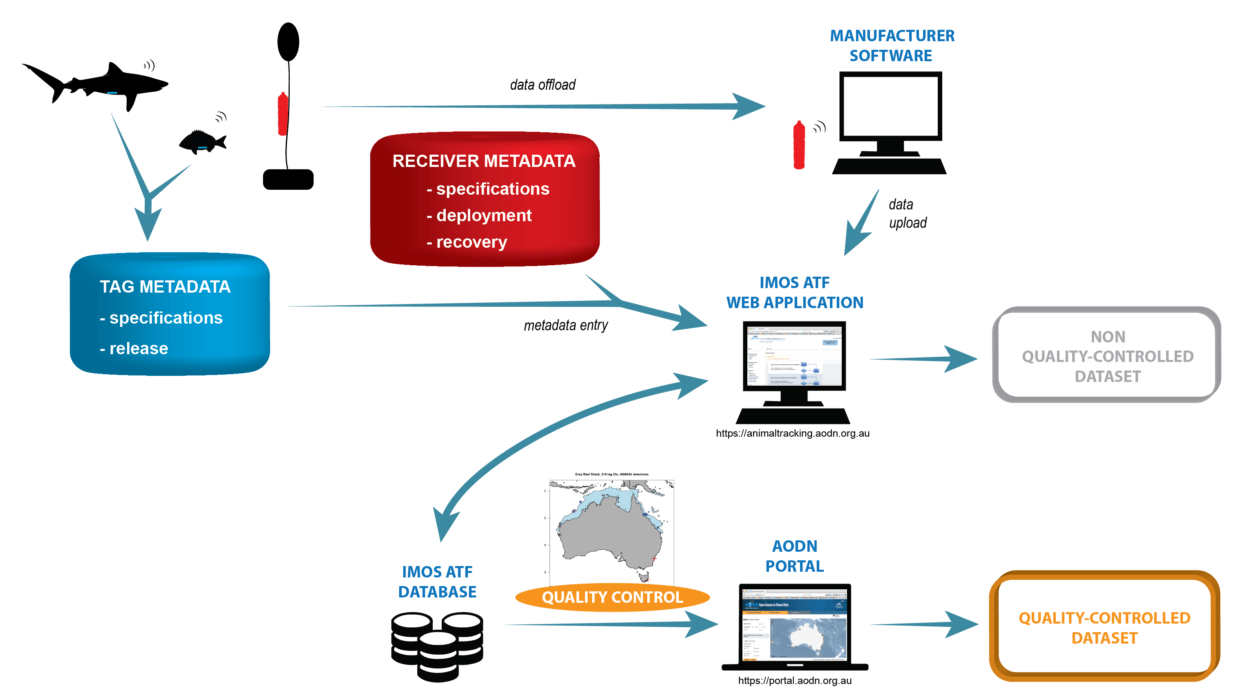
Data flow and quality control
Five tests:
False Detection Algorithm
Velocity: > 10 m.s⁻¹
Distance: > 1000 km
Detection distribution
Distance from release site
Detections then flagged:
Passed all → valid
Failed one → likely valid
Failed two → likely invalid
Failed >= 3 → invalid

Slide 12
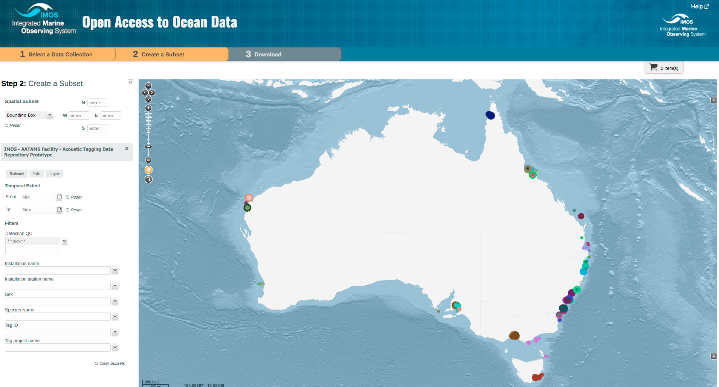
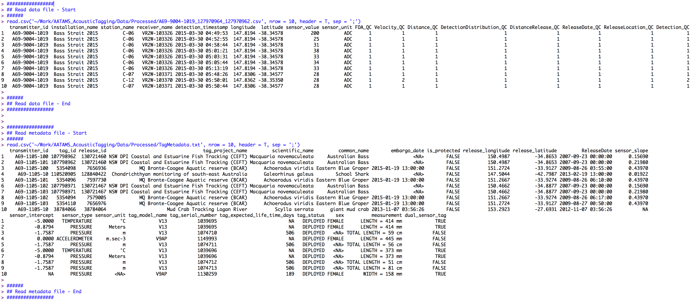
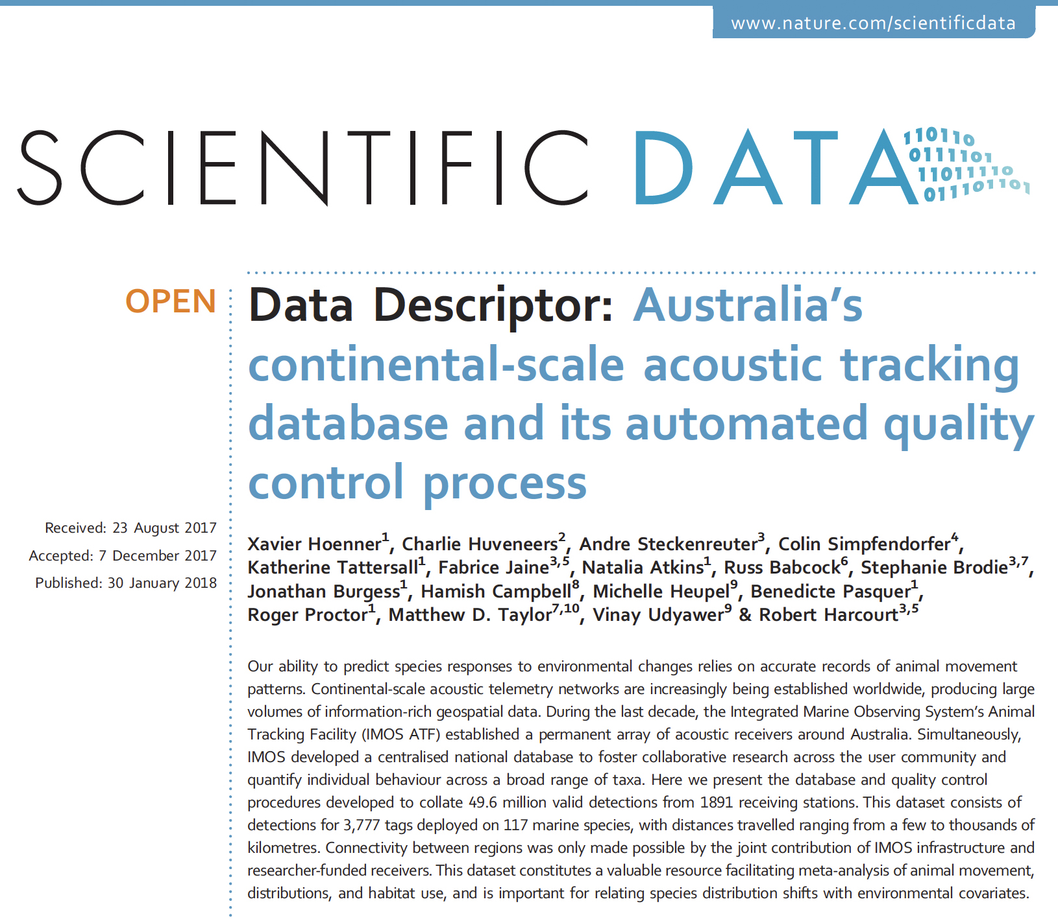
Data format and delivery

Slide 13
